Slide 1


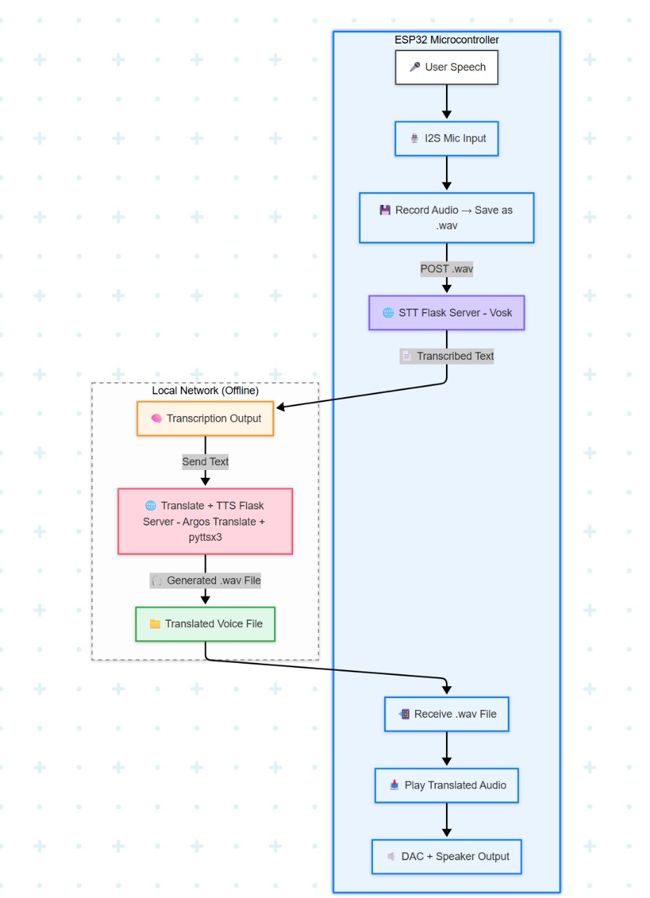
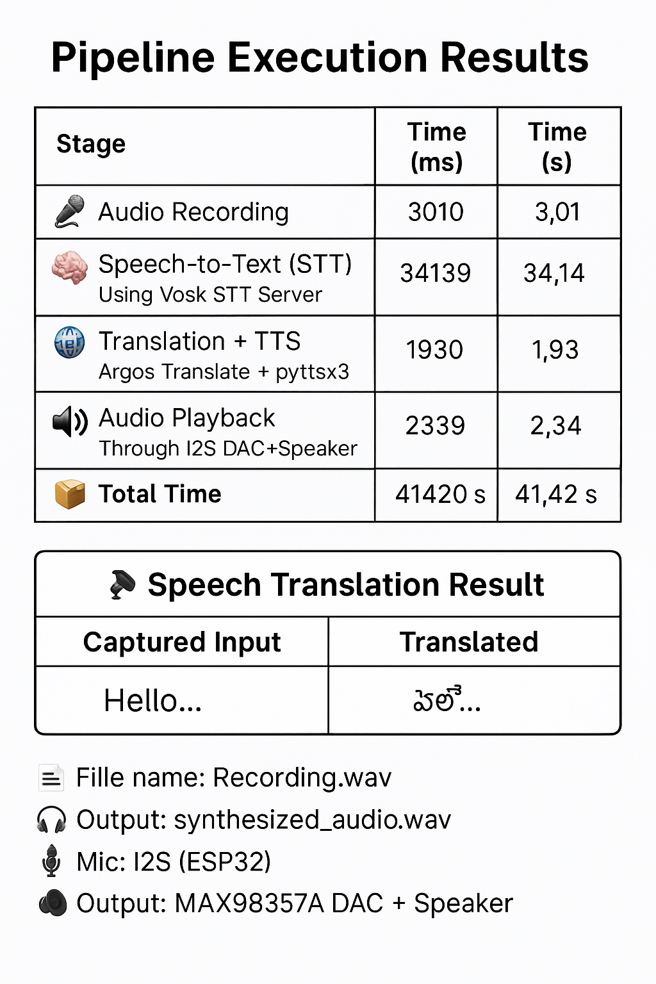
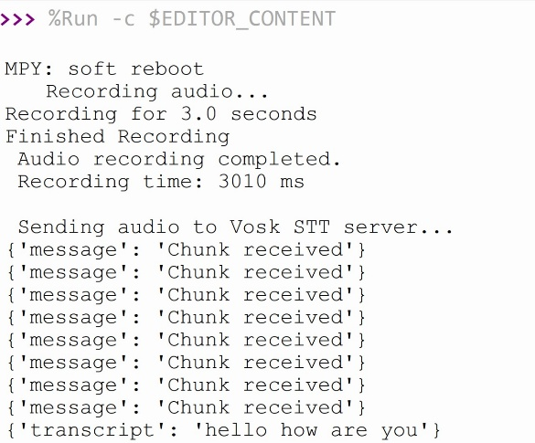
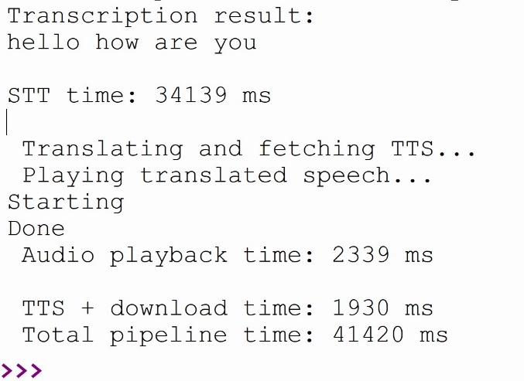
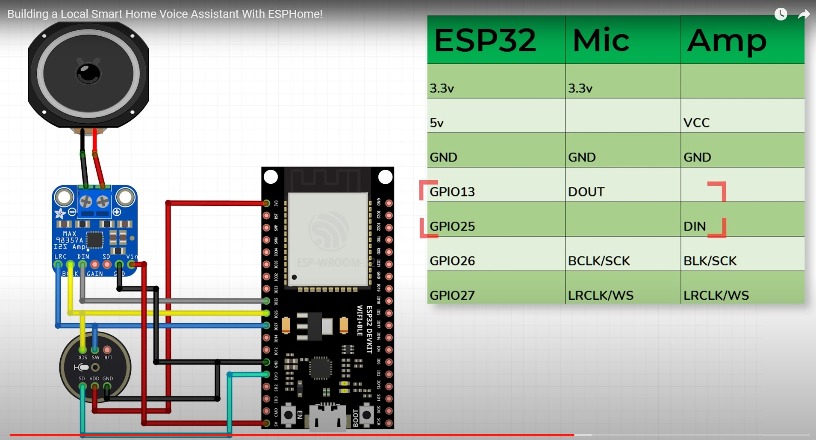
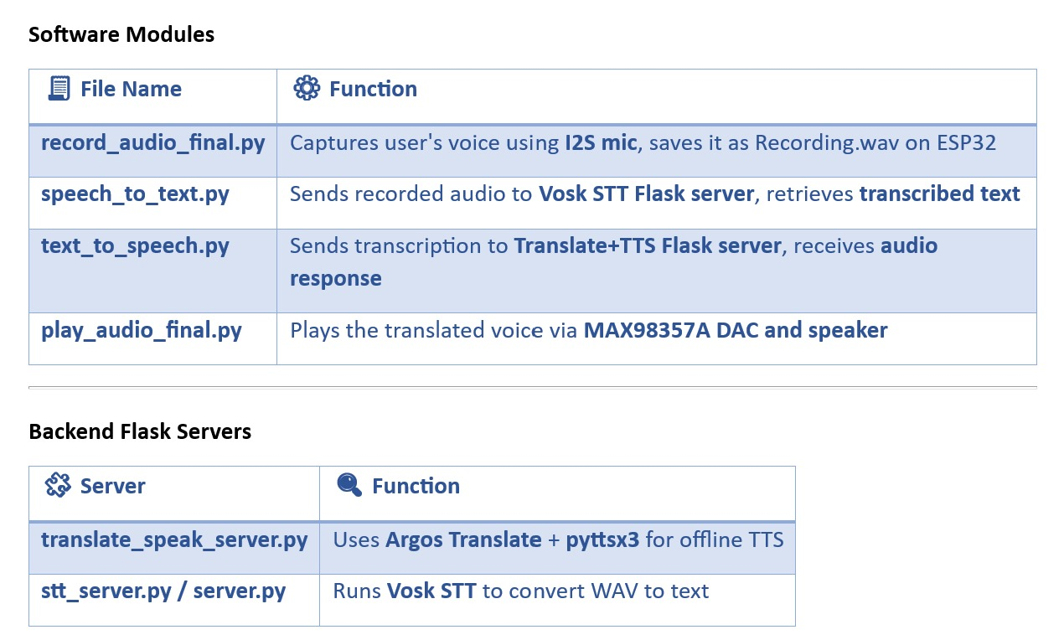
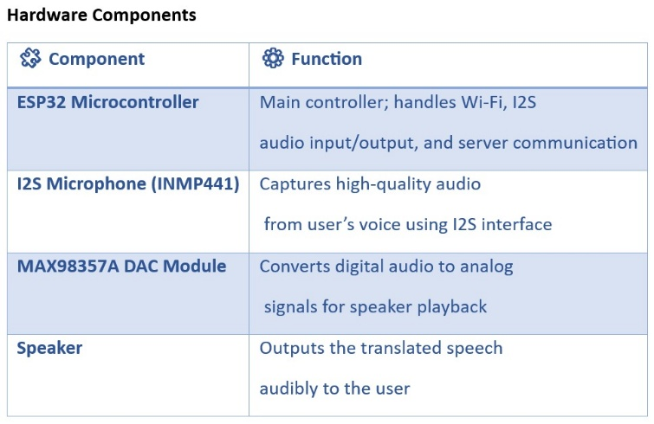
Real-Time Multilingual Voice Translator with ESP32 and AI Integration AIOT & it’s applications
BY: V. ABHIVARUN , CHARUL PAREEK , DIVYANSHU SHEKHAR, KRUTHIKA PRIYA CHANDAN
RESULT
Overview
FlowChart
Future Enhancements
Detecting text using esp32
References
Acknowledgments
This is an offline AI-based speech-to-speech translator project centering on the ESP32 microcontroller that can facilitate real-time communication in multiple languages without being dependent on the internet. It records spoken data via an I2S microphone, performs on-device audio processing with Vosk to perform speech-to-text, translates the transcribed text using Argos Translate, and generates output speech using pyttsx3, all on a local server written in Flask. The translated audio output is heard via a speaker, which is connected to the ESP32, which is great since it requires no connectivity or can be used in low connectivity areas such as rural zones, traveling, or schools. It can be highlighted that its full offline support, cheap hardware, modular design, and multilingual support (e.g., English to Hindi/Telugu) are its important qualities. future features might include LLMs to respond in context or a mobile app to pick the language.
INPUT
OUTPUT
CONCLUSION
Schematic Diagram
This project demonstrates a low-cost, offline-capable speech translator using ESP32 and edge AI, bridging embedded systems with real-time language processing. Future work focuses on optimizing latency, expanding languages, and reducing server dependency—paving the way for standalone, battery-powered translators. Ideal for education, travel, and IoT, it highlights the potential of on-device AI for accessible, privacy-first communication
1. All-in-One Embedded Solution (Without Laptop/RPi) Integrate models directly on a more powerful embedded board (e.g., Raspberry Pi Zero 2 W or Jetson Nano) to eliminate the need for external PC. 2. Wake Word Detection or Language Switching Interface Implement local wake word detection (e.g., “Hey Translator”) for more intuitive, hands-free interaction. 3. Noise Reduction Techniques
Add signal filtering or lightweight ML-based noise suppression for better mic performance in the field. 4. Language Expansion Add support for more regional and international languages (e.g., Tamil, Marathi, Bengali, Spanish) by downloading/installing new Argos Translate models.
P. Kshirsgar, "Advances in Offline Speech Processing," Springer Nature, Singapore, 2020. This is highly relevant as it directly covers offline speech processing, which matches your project's core innovation of working without internet connectivity.
A. Ismail, "Deep Learning-Based Speech Translation and Sustainability," Sustainability, vol. 12, p. 2403, 2020. This reference is valuable because it focuses on speech translation and edge AI sustainability, which relates to your low-power ESP32 implementation.
G. K. K. Sanjivani S. Bhabad, "An Overview of Technical Progress in Speech Recognition," International Journal of Advanced Research in Computer Science and Software Engineering, 2013. This provides fundamental insights into speech recognition technology, supporting the Vosk/STT component of your project.
Kaveri Kamble, Ramesh Kagalkar, "A Review: Translation of Text to Speech Conversation for Hindi Language," International Journal of Science and Research (IJSR), 2012. This is particularly relevant as it discusses text-to-speech conversion for Hindi, one of your target languages.
Chethan, "Offline Voice-Based Applications," International Journal of Engineering Research and Technology (IJERT), vol. 2, no. 5, 2017. This reference is important as it explores offline voice systems, which is crucial for your project's internet-independent operation.
.
Components And Modules
We thank our mentors for their guidance and the open-source community for valuable resources. Special thanks to our friends and family for their support and encouragement.

